Slide 1
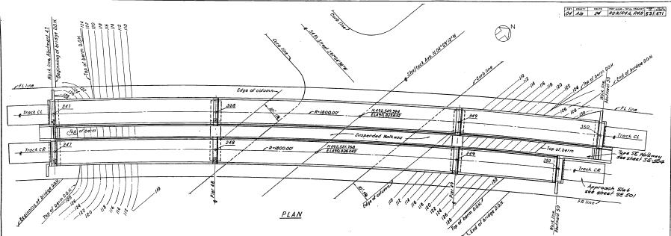
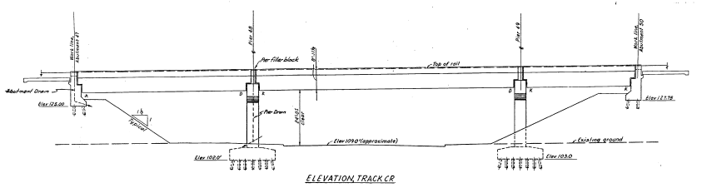
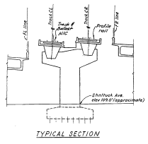
Tasks 3 & 4: Developing detailed FE models and Conducting nonlinear dynamic analyses: Aerial Structure I
Rockridge:
Shattuck Ave

Slide 2
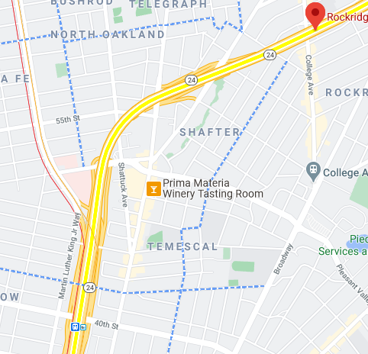
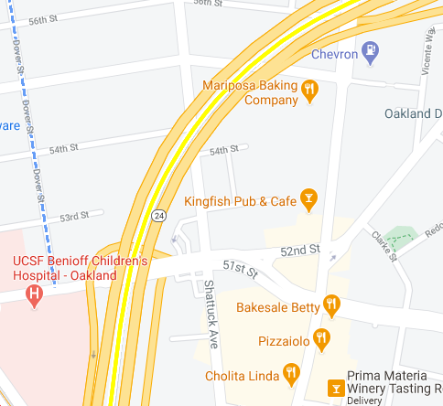
Tasks 3 & 4: Developing detailed FE models and Conducting nonlinear dynamic analyses: Aerial Structure I
BART railway
Highway
Because of the curve and the centrifugal force, this aerial structure provides an opportunity to demonstrate the difference between two cases: a) train moving and b) train stopped or moving slowly
This aerial structure is midway between two BART stations: Rockridge and MacArthur

Slide 3
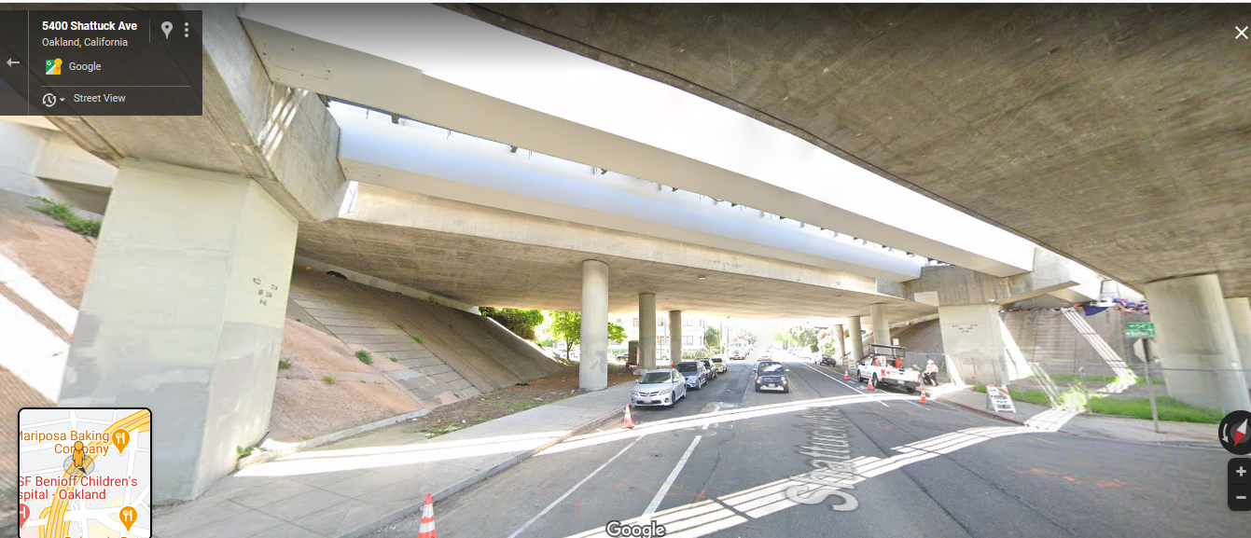
Tasks 3 & 4: Developing detailed FE models and Conducting nonlinear dynamic analyses: Aerial Structure I
Because it is a stiff structure and likely has a short period, accelerations due to earthquake shaking on the aerial girder level will be large
T (sec)

Slide 4
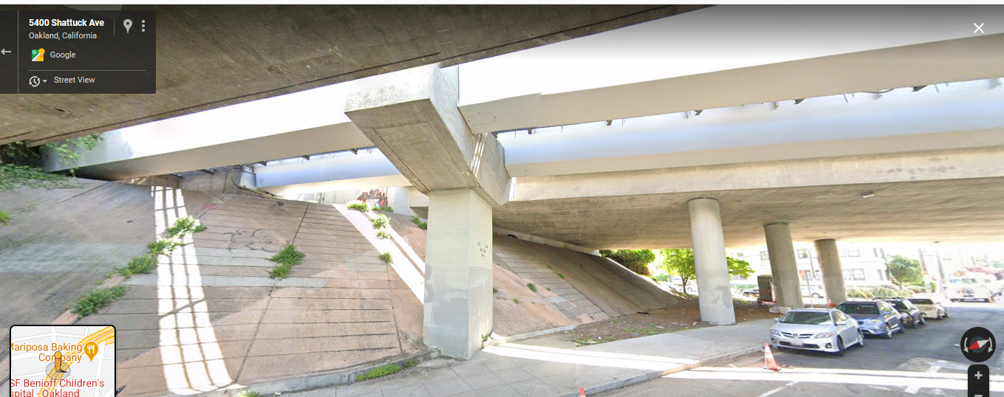
Tasks 3 & 4: Developing detailed FE models and Conducting nonlinear dynamic analyses: Aerial Structure I

Slide 5
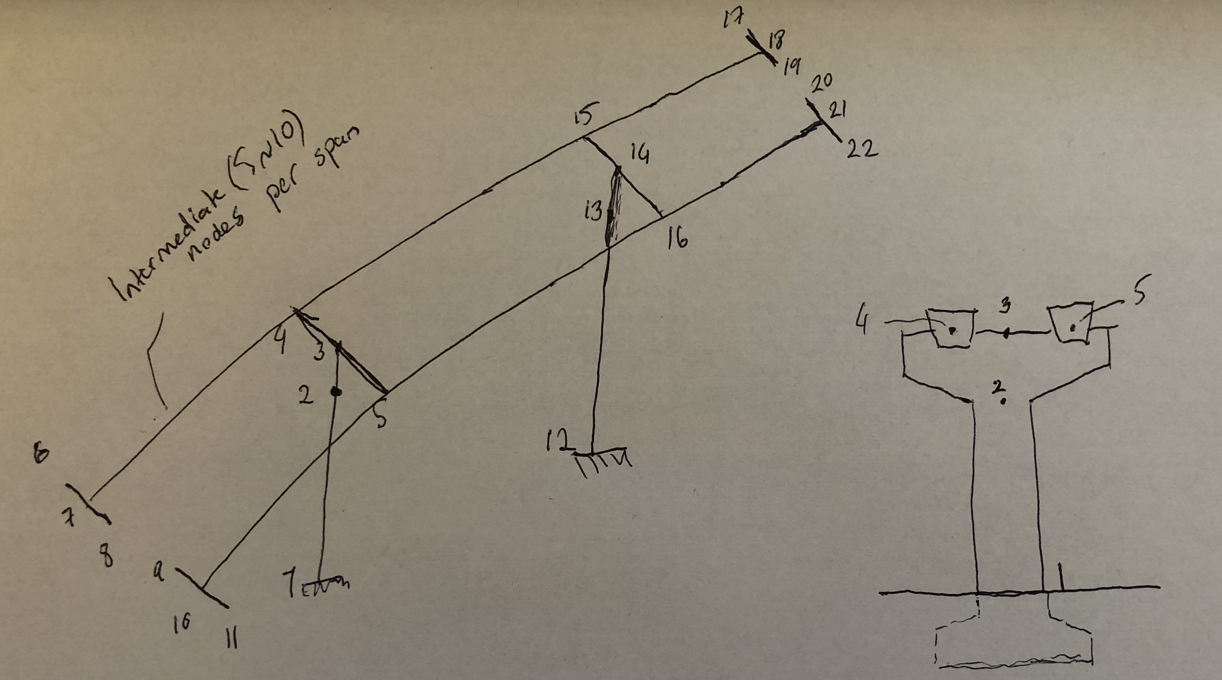
Tasks 3 & 4: Developing detailed FE models and Conducting nonlinear dynamic analyses: Aerial Structure I
Relevant pages on the pdf: 25-28
Abutment 50
Abutments
2
3
4
6
1
5
124
CL
CR
224
121
Bent 49
CL
CR
114
221
CL
111
Bent 48
214
211
CR
Abutment 47

Slide 6
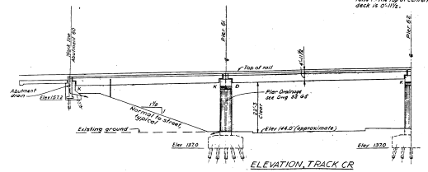
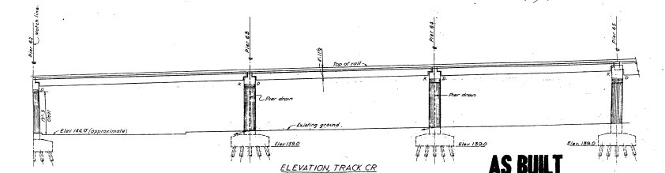
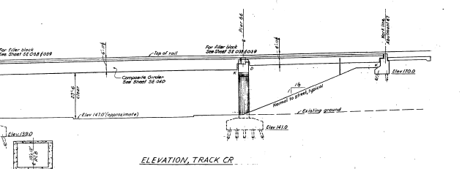
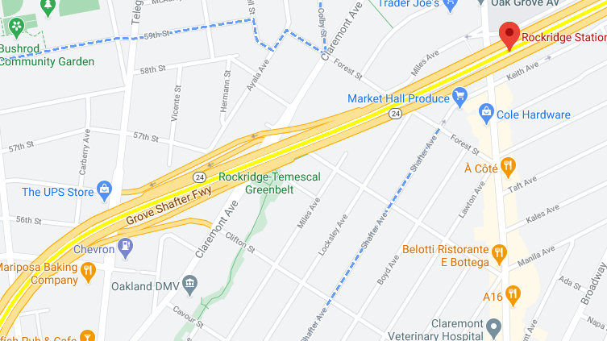
Tasks 3 & 4: Developing detailed FE models and Conducting nonlinear dynamic analyses: Aerial Structure II
Rockridge: Claremont Ave

Slide 7
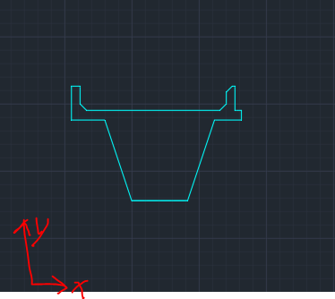
Tasks 3 & 4: Developing detailed FE models and Conducting nonlinear dynamic analyses: Aerial Structure II

Slide 8
Tasks 3 & 4: Developing detailed FE models and Conducting nonlinear dynamic analyses: Aerial Structure II
z
y
x
 | Conventional sensor channel | Microcontroller sensor channel
x | 1
y | 2
z | 3

